Slide 1

Spend And Get On Model Engine
Kwazikwenkosi Buthelezi
Notes:
Add the sampling thing, technical aspects around the model,

Slide 2
Use Case Summary
Name:
Spend And Get DRC
Business Goal:
Spend and Get(SAG) is part of the Revenue boost initiative. The goal of this project is to encourage customers to stretch their weekly spending by projecting weekly spend targets and rewarding customers who meet these targets.
How will ML be applied to solve the problem?:
A supervised regression model was used to predict customer’s weekly
spend across voice, data and sms.
Model Type:
XGboost regressor
Notes:
Business Goal:
Spend and Get(SAG) is a revenue-boosting initiative. The goal of this project is to encourage customers to stretch their
weekly spending by projecting weekly spend targets and rewarding customers who meet these targets

Slide 3
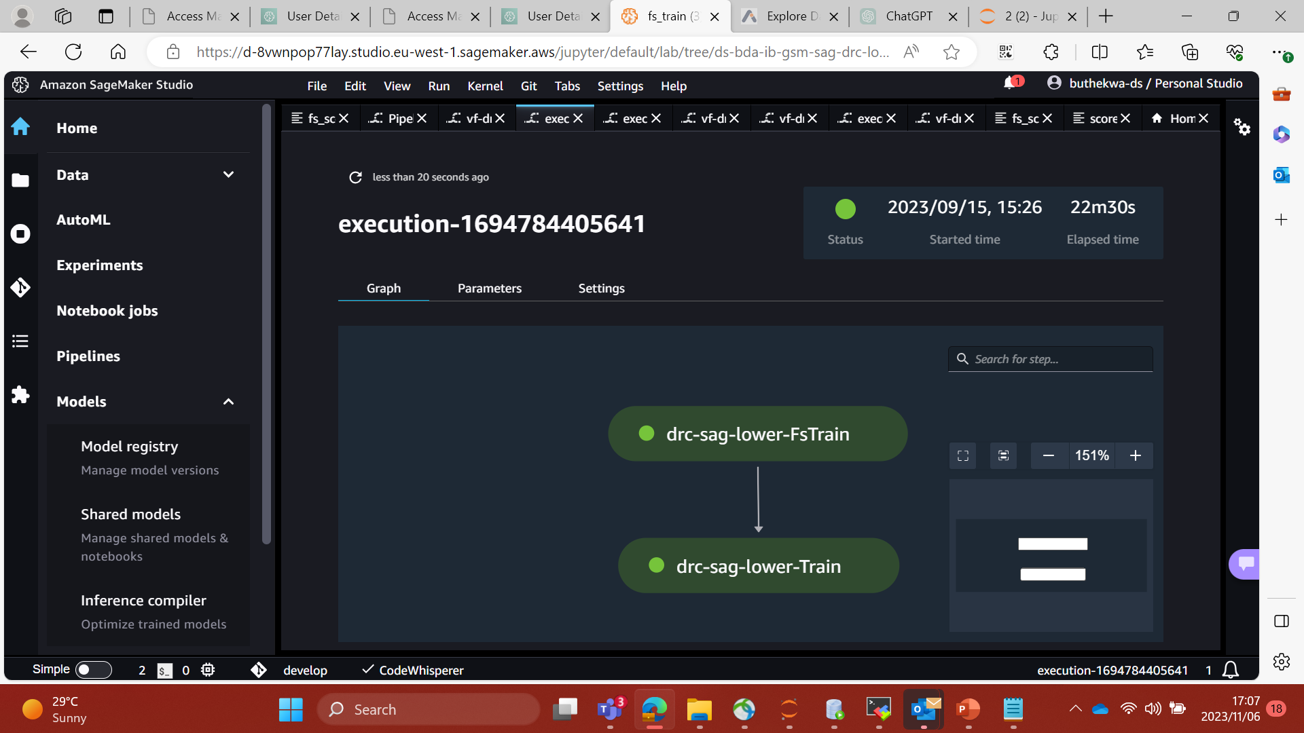
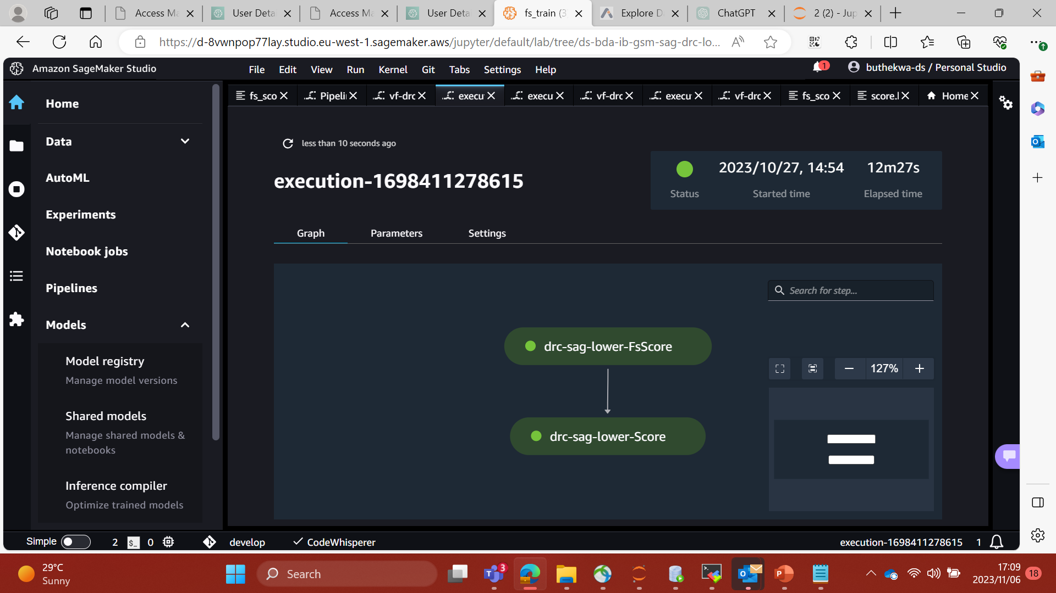
Model Engine Overview | Migration from Premises to CLOUD
Training and Scoring Pipelines
Model Engine
Model was first trained on Prem now is migrated to
CLOUD
The model is now trained and deployed using
Model Engine
Pre-processing
Train & Test
Scoring
Post-Scoring Logic and Validations
Model Optimization on Cloud
On Hocon
Model Params: Objective function to Tweedie
Model Deployment Efficiency.
Define more features:
In bundle and Out bundle
Notes:
Fs in fs_train and fs_score stands for feature store
Model Engine:
The initial model was trained on prem, and I have now migrated it onto AWS
I have trained and deployed the model using Model Engine
Cloud Benefit:
Model Params: The objective function used is Tweedie (notes to Kwazi: Speak on the old one that was used and how this optimizes the model performance)

Slide 4
Data Collection Summary | Features and Eligible Base
Data Source
Eligible Base
Period
Target Variable
Train & Test
Recharge Agg Table
Voice Agg Table
SMS Agg Table
Data Agg Table
Spend> 0 on either week 1,2,3 or 4
GSM Tenure >= 3 Months
4 months (Apr –Jul 2023)
Observation Period: April – June
Target Month: July
Voice Charges from Weeks 1-4
SMS Charges from Weeks 1-4
Data Charges from Weeks 1-4
Model : Regression.
Train size 80% dataset
Test size 20% dataset
Dataset after filtering the eligible base
Features Used:
Customer Tenure months
Customer value segments
Transactional/Behavioural
Recharge Amounts (Mpesa versus GSM, total recharges)
Recharge counts
Voice duration, counts and charge amounts
Data usage, counts and charge amounts
SMS counts and charge amounts
Eligible base is 29% of the total base

Slide 5
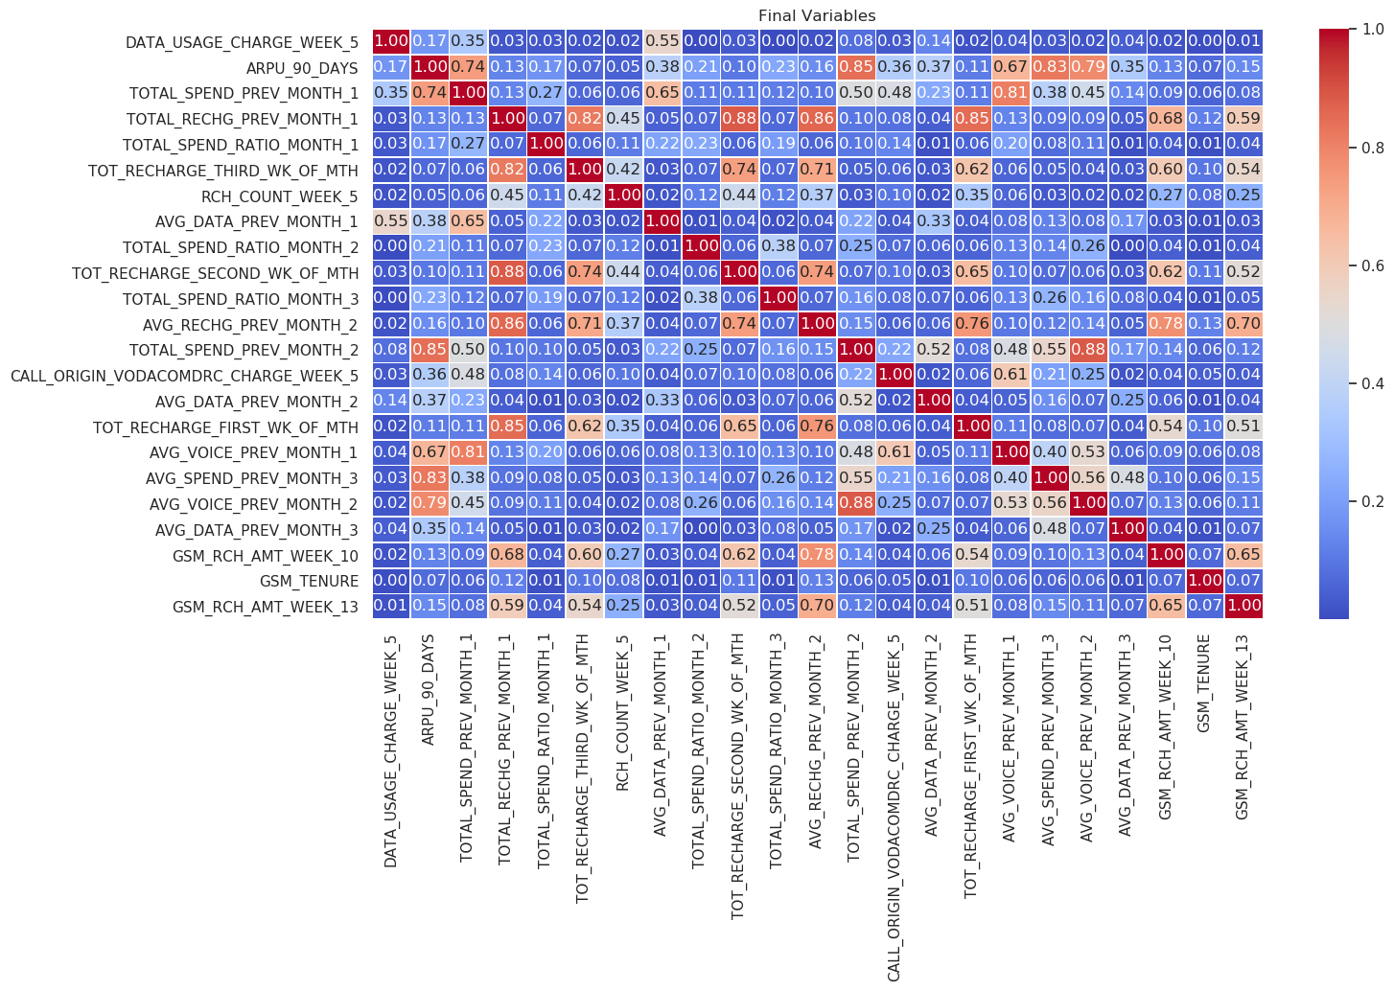
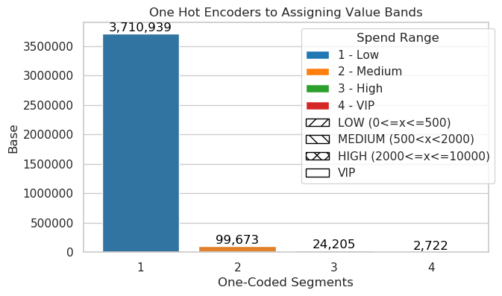
Feature Engineering | Pre-Processing
Filtered eligible base
Divided amounts by 10 000 to convert to dollar cents
Created target variable
Dropped highly correlated features
Removed outliers
Encoded categorical variables
Imputed nulls with zeros
(e.g ARPU 90 days)
The eligible base was separated into Upper and Lower Segments
Upper Segment / Lower Segment Split
25:75
96.7%
2.6%
0.6%
0.007%
5
Notes:
Feedback from Riva: Put aside the value segment to see the performance of the model
Feedback from Teballo: Train model on all features first, to see importance then drop highly correlated features.

Slide 6
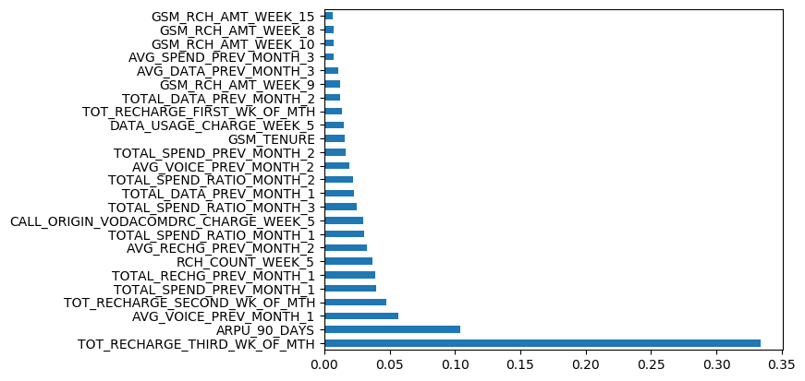
Final Variables |Permutation Feature Importance
Funnel bar of permutation importance features
Feature Engineering
Xg boost
regressor
Modelling
Train & Test
Selects
Top 25
Features
Permutation
importance
Calculates the
metric
Permutation importance
Top 25 most important features selected using feature importance
Notes:
What do you mean by Permutation Importance is it Permutation Feature Model ????

Slide 7
Model Metric | Model Performance Evaluation
Model Engine Metrics
Under Model Registry the following metrics for Spend And Get were recorded
Lower Segment
Upper Segment
Metric | Measure ($)
Mean Monthly Spend | 0.14
MAE | 0.092
RSME | 0.12
R squared | 0.41
Metric | Measure ($)
Mean Monthly Spend | 1.19
MAE | 0.43
RSME | 1.29
R squared | 0.66
Notes:
Fs in fs_train and fs_score stands for feature store

